Slide 1

Wits Softdev 2016 Session 1
By Jason Chalom

Slide 2
Introduction
This course is designed to help introduce you to the world of software development.
It will provide a taste of what to expect
And some links will be provided.
We will be using the MEAN stack.
This contains NodeJS, ExpressJS, AngularJS and MongoDb
This lesson we will be covering NodeJS and some basic concepts.

Slide 3
Some Interesting Links
http://nodeschool.io/
A collection of interactive tutorials
A suggestion is to do the ones on JavaScript, npm, node, express and git.
https://try.github.io
Interactive git tutorial from a web browser

Slide 4
Tools You Will Need
Git For Windows
Includes Git Bash
NodeJS
Includes npm
https://nodejs.org/en/download/
MongoDb
Used later
https://www.mongodb.com/download-center
RoboMongo
https://robomongo.org/download
A code Editor – any will do
Npm programs

Slide 5
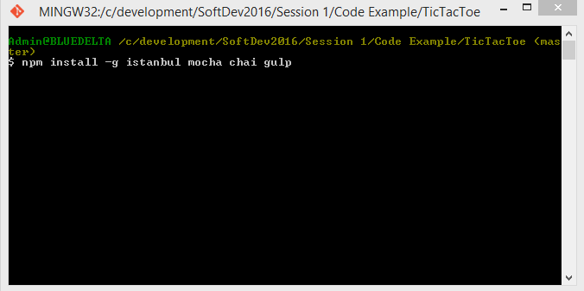
NPM
Once NodeJS is installed, on Windows you may need to add NodeJS to the main path
This link will help: http://blog.gvm-it.eu/post/20404719601/getting-started-with-nodejs-on-windows
I use git bash for all my examples
Install these programs with npm:
They will be used in later sessions
This will also work with the
standard Windows CMD

Slide 6
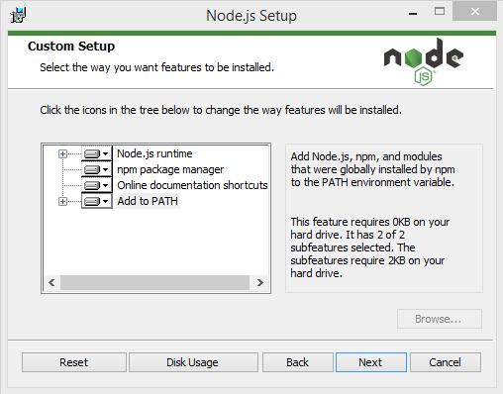
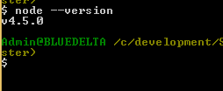
Make sure to Add to Path
Typing “node --version” into the terminal, should return the node version

Slide 7
What is Software Design
It is more than just programming
It is the use of techniques such as analysis, design with programming and testing to develop robust software to solve real world problems.
Trying to solve a problem before you truly understand and know the problem can lead to disastrous problems
Feature Creep
Bugs
Or even the wrong program being made.

Slide 8
Working As A team
Important for output quality
Constructing large systems effectively and quickly
Efficiency
Division of work
Morale

Slide 9
Development Strategies
There are general strategies which have defined academic definitions
These are used as a guideline for how a project should be structured
Command structure
Work structure
Documentation
Testing
Implementation
There is also the high level development strategy set out to achieve the objectives of the project

Slide 10
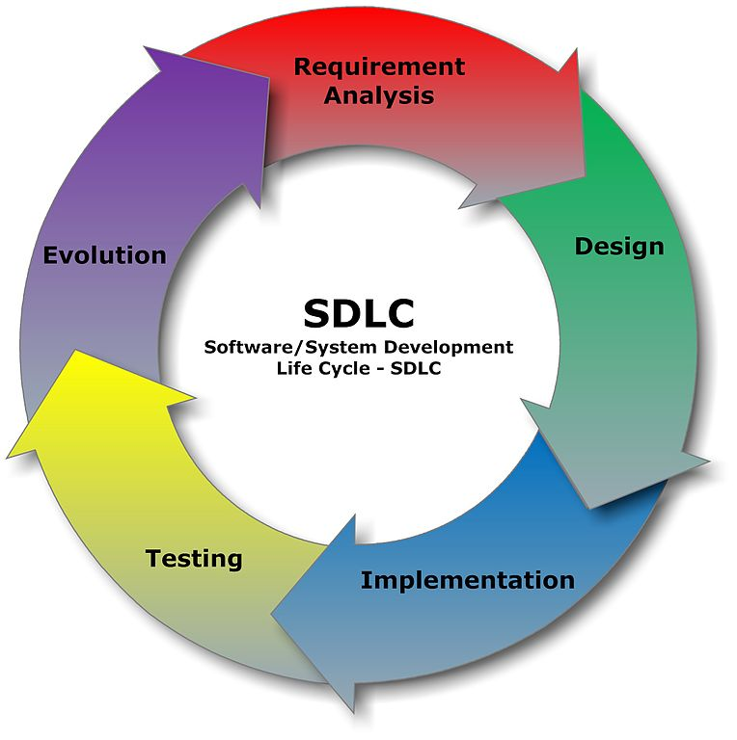
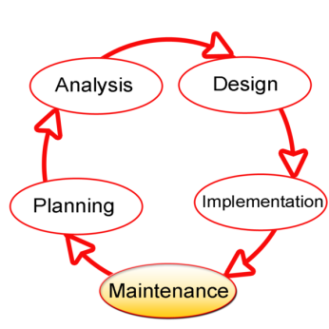
Software Development Life Cycle (SDLC)
The process of producing an information system
Also known as the software development process
Dividing the process of making software into distinct phases or parts
Different models or divisions refer to different development methodologies
The oldest monolithic methodology
Very Rigid

Slide 11
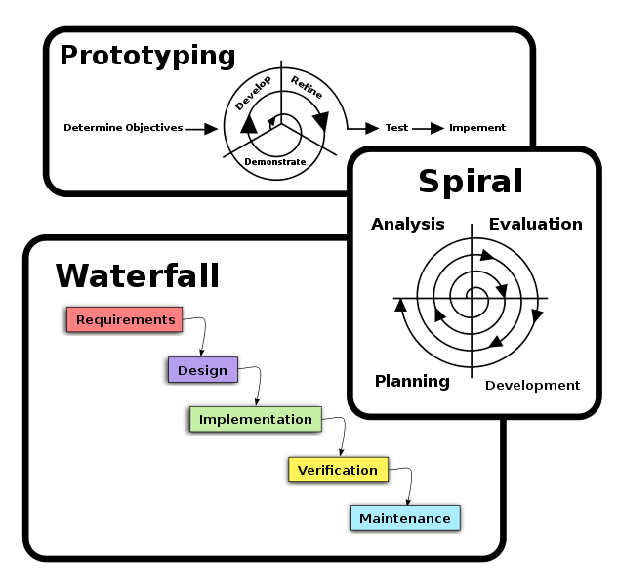
Classical
There are many different methodologies and variations of methodologies, we will only cover a few
The “classical” or traditional approaches tend to have more distinct phases
SDLC directly refers to these approaches, life cycle approaches come later on.
These distinct phases were considered to occur as their own individual units and also not concurrently.

Slide 12
Agile Approach
Much more modern set of methodologies
Evolving solutions
Collaboration of smaller cross-functional teams
Adaptive planning
Evolutionary development
Early delivery
Flexibility (rapid response to change)
Continuous improvement

Slide 13
1. Version Control
A system which helps to track the progression of a project
It manages and track the changes of all the files within the repository except those specific not to be tracked.
In a corporate environment it is usually stored on a separate or external server
Used when teams of developers are working together so that a copy of the project at any point within the version control system can be retrieved
Handles conflict management between different versions

Slide 14
Why Is Version Control Important?
Tracking changes helps track what code introduces a bug
You can do “more dangerous” edits to code
Working as a team can be faster and more efficient
Keeps a backup of EVERY state of your project
Helps distribute the latest code to all team members efficiently and securely

Slide 15
There are 2 types of version control
Centralised
Server based
Requires a connection to the server
E.g. SVN, CVS, Team Foundation Server (The newer versions use a custom version of git in some cases)
Distributed
Everyone has a copy of the entire code repository
Works offline
E.g. Mercurial, git

Slide 16
We will be focusing only on git
A good resource is GitHub (http://www.github.com)
https://try.github.io
Provides free student paid version for two years
https://education.github.com/discount_requests/new
You need to have your student email connected to your account
Also provides free web hosting
Node school (mentioned earlier) is also a good resource
There are a lot of tools which can be used with it
GitHub for Windows
Git Extensions – my favourite graphical one
Git bash for Windows
Many others

Slide 17
Git Terminology
Repository: a stored history of work
Origin: the main repository
Commit: state of repository at a given time
Branch: a series of commits
Master: the “main” branch
Working copy: the assets you are working with

Slide 18
Common Git Workflow
Master Branch -> CI -> automated deployment
Develop Branch -> CI -> QA deployment
Sub branches <- hotfixes and feature requests

Slide 19
Continuous Integration (CI)
Similar concept to source control
Operates along side source control
It is a shared repository where the code is pushed periodically by the developer and an automated bot attempts to build the code.
The bot may also just use the source control system and check for any new commits
Usually there will be some kind of interface where the result of the build is displayed
Either pass or fail
Some CI systems can also automatically deploy the code to its “live” version

Slide 20
Why Use A CI
Makes sure that the recent code changes are working so that if there is already a released version of the software this update does not break the software
Allows teams to see where some lower level errors may exist
In team based projects it is important to see where the latest revision of the project is and if it is indeed working
Test-first development strategies
Centralised deployment mechanism

Slide 21
Examples of Online CI Services
https://travis-ci.org/
https://www.appveyor.com/
We will cover testing later

Slide 22
Use Cases
A structured way to show a mapping between one or few actions and 1 or few objects
Usually dictated as noun → verb → noun
E.g.
The manager hires new employees
The doctor treats patients
Mappings related to how the data is stored and what screens are shown to the user
Important way to constrain the problem in order to make it easier to deal with

Slide 23
User Stories
Similar to use cases but is in story form
The “user” is usually a made up persona which represents the type of person most likely to use the piece of software.
An example is shown later

Slide 24
Issue / Ticket Tracking
GitHub has it built in
http://waffle.io/
Similar concept to the tickets a kitchen at a restaurant gets for an order
Based on the use cases / user stories
Usually subtasks of a much larger objective based on a specific use case

Slide 25
An Example Using NodeJS
The main code example will be the game TicTacToe.
A User Story: “Dave loves the game TicTacToe. Unfortunately Dave has no one to play the game with. He would like to be able to play the game on his computer. He wants to be able to see a game board and input the move he wants to make when it is his turn.”
Use Cases:
The Computer Starts A New Game
The Computer Makes the First Move
The User Can Make Moves
Player Wins When Three Squares In A Row are Captured
The Winner is Declared

Slide 26
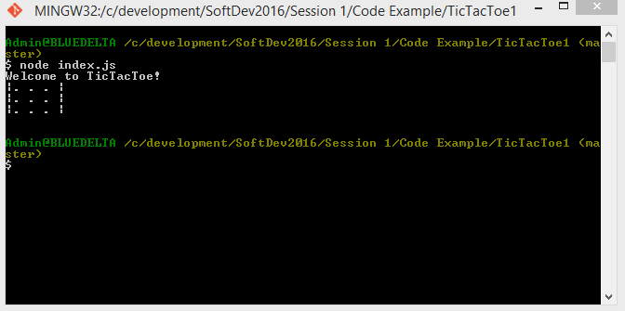
Running the first example

Slide 27
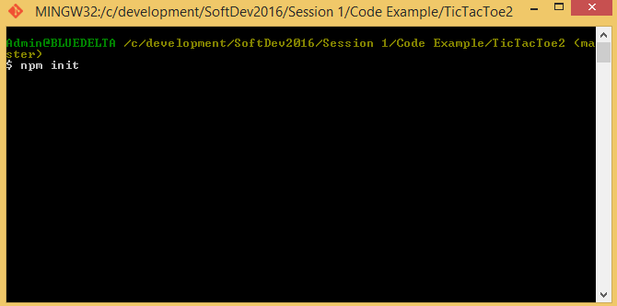

Second Example Installing a Library

